Slide 1

PENS AND PRINTERS
SALES STRATEGY ANALYSIS

Slide 2
This report aims to provide an analysis of the sales strategies used by Pens and Printers for its new product line, launched six weeks ago.
The report will address the following questions raised by the Sales Rep:
How many customers were there for each approach?
What does the spread of the revenue look like overall? And for each method?
Was there any difference in revenue over time for each of the methods?
Based on the data, which method would you recommend we continue to use?
INTRODUCTION

Slide 3
The business goals of this analysis are to determine the most effective sales strategy for the new product line of Pens and Printers. By analyzing the data, we aim to identify the sales method that generates the highest revenue and recommend a strategy for continued use. Additionally, we will explore the customer characteristics of each group to understand the differences between them and provide some context for our analysis. The results of this analysis will help the sales team to make data-driven decisions and improve their sales approach.
BUSINESS GOALS

Slide 4
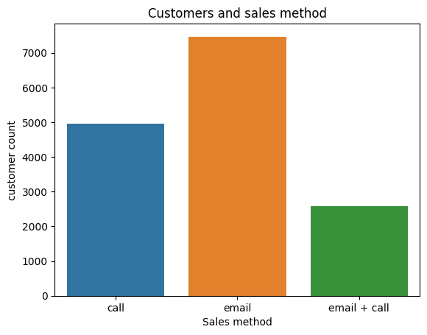
Customers by sales methods –BAR CHART
From 15000 customers here we can see that email was used by the majority of the customers with over 7000 count, followed by calls, with about 5000 customers, then by combination of both email and calls which was used by around 2500 customers.

Slide 5
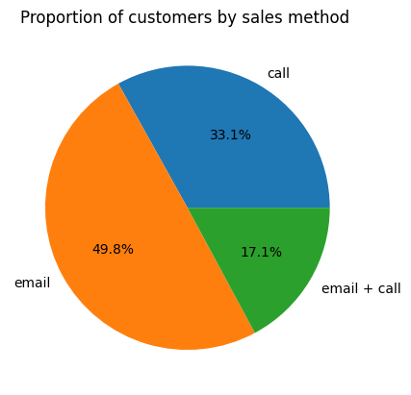
Proportion of customers by sale methods
We can clearly visualize the proportion of customers from this pie chart, approximately half of the customers were using email as their sales method, while around one-third were using calls.

Slide 6
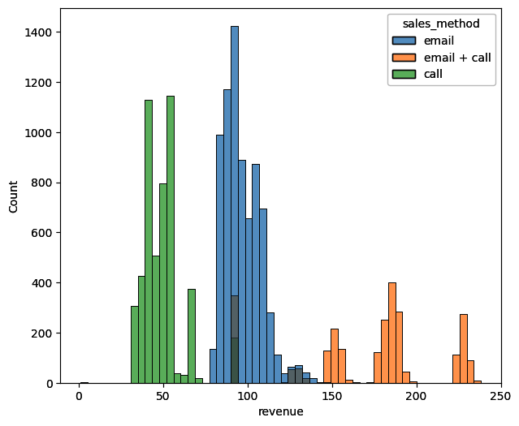
REVENUE DISTRIBUTION plot
As we can see here the revenue distribution is right skewed, more purchases are done by prices around 100$ and then around 50$. We can also visualize that each sales method was focused on each price segment. The email method have most purchases and the combination of email and call have the least count.

Slide 7
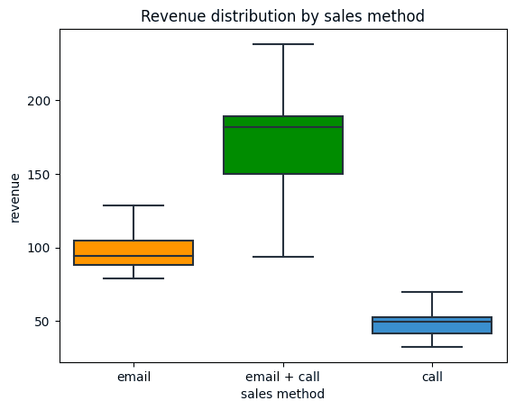
Revenue distribution by sales method
Based on the revenue data analysis, we observed and interesting trend with regards to the sales methods used by customers, even though customers who used the combination method was low, they tends to purchase in wide price range.

Slide 8
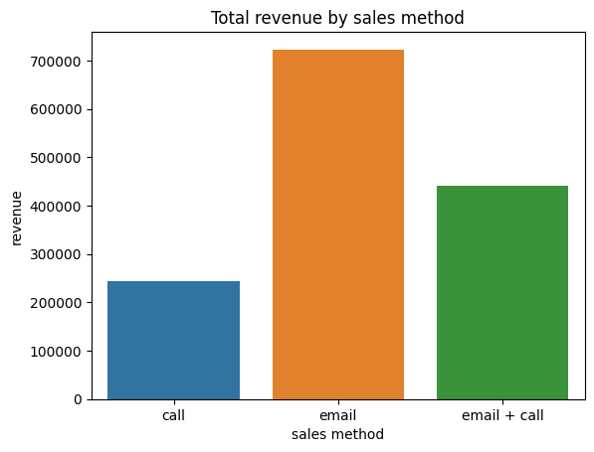
Total revenue by sales method
We found that email is the primary source of revenue and our most customers were using this channel. These findings may show that the most effective approach for generating revenue for the company. And least revenue was created by the call method.

Slide 9
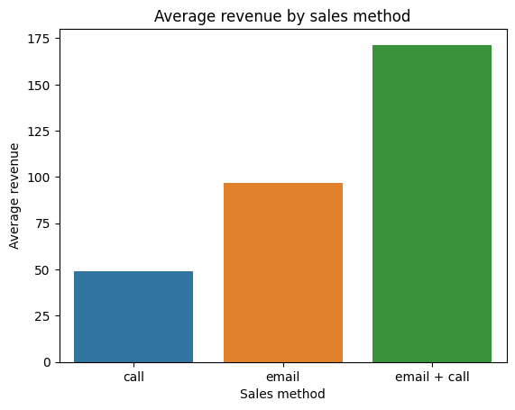
Average revenue by sales method
The data shows the combination method have the highest average revenue and call have the least. This indicates that the combination method have the highest conversion rate than email or call. We can further analyze the effectiveness of the sales method over weekly revenue.

Slide 10
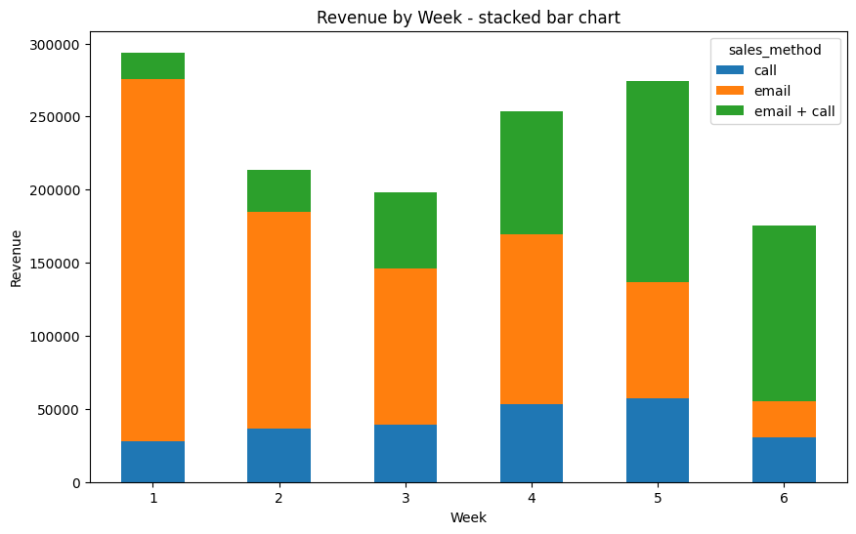
Weekly revenue by sales method
While analyzing weekly revenue by sales method, we can visualize that there is no trend in total revenue over week. But interestingly, there is a huge declination in email revenue, and increase in combination strategy. We can also clearly see that the most of the revenue produced by email method was generated in the first week itself.

Slide 11
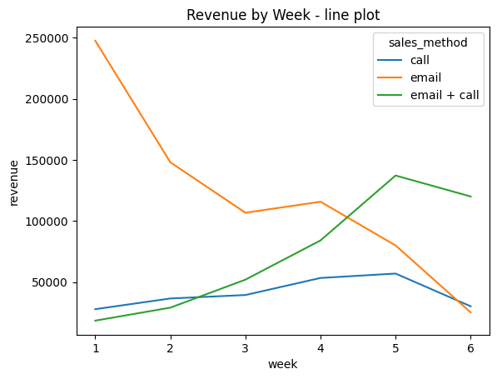
Average revenue by sales method-line plot
We can clearly detect the weekly trend of revenue by sales method. specifically, while the revenue generated through email alone is declining significantly week by week, the revenue generated by email and call is increasing steadily while the revenue by call is maintaining its consistency.

Slide 12
The combination of email and call generates the highest average revenue by sales method and is effective in increasing weekly revenue.
While email alone generates the highest revenue, it declines drastically after the first week. Thus, adopting the 'email + call' method is recommended for sustaining revenue growth over time.
Customers using the email with call method tend to make purchases in higher values, making it a valuable metric for evaluating customer behavior and preferences.
BUSINESS METRICS

Slide 13
We can opt for combination sale strategy as it can generate high-value purchases and reach a wide range of customers
This method is more efficient than the call method, as it requires an average of only 10 minutes of call time and minimal effort from our team when sending the email
Enhance the effectiveness of the 'email and call' method by improving the email content
Follow up with a call after sending the email to improve customer relationships and increase the likelihood of closing a deal
Offer personalized deals to high-value customers to help prevent customer churn and increase loyalty
Create a feedback system in the email to provide valuable insights into customer preferences and needs
Monitor revenue over a longer period, such as monthly revenue, to identify trends and inform necessary changes to the sales method.
RECOMMENDATIONS

